Slide 1
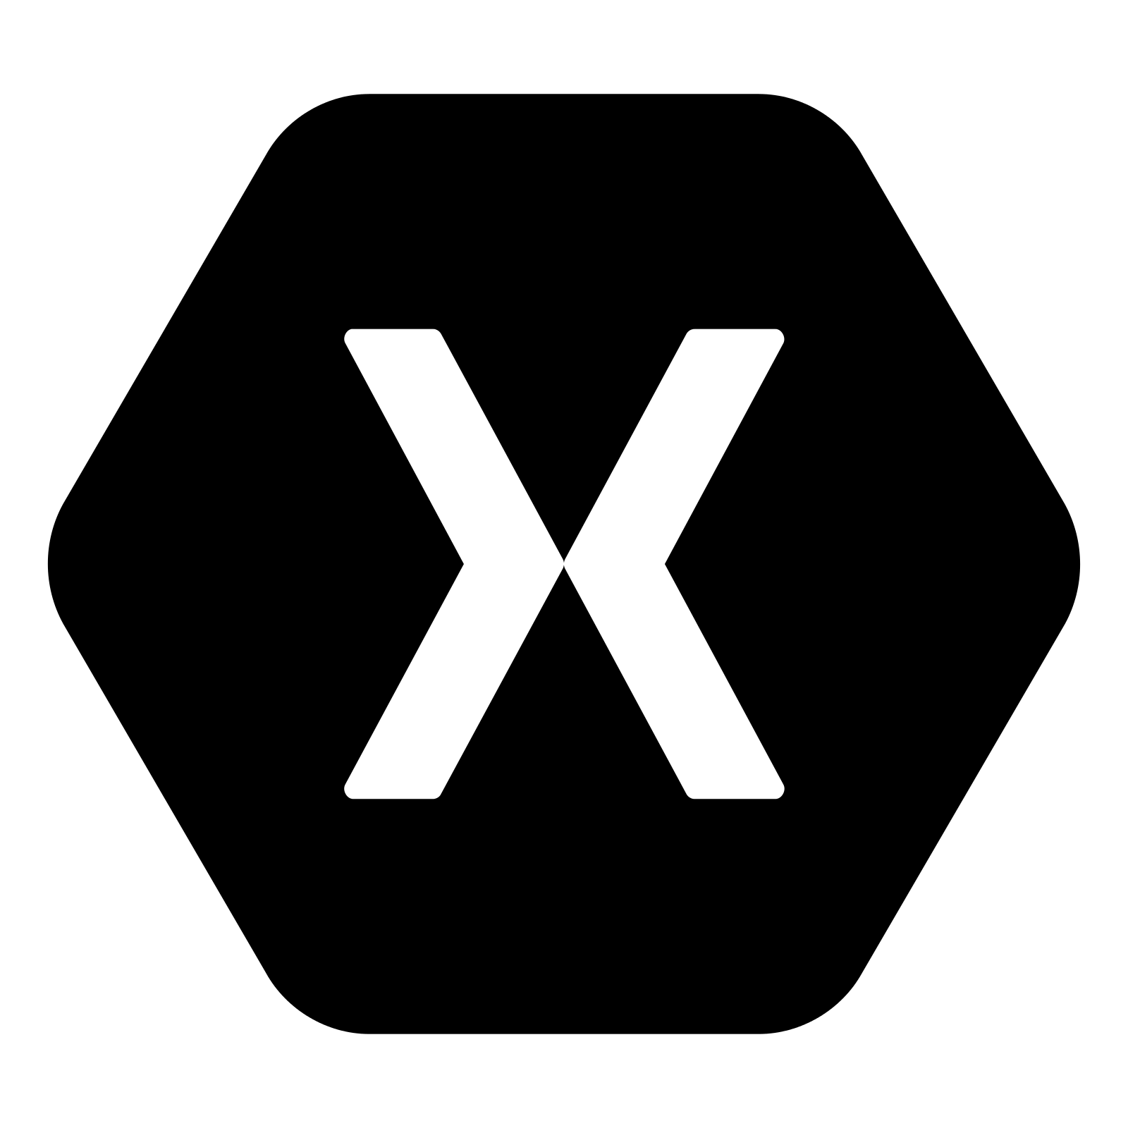



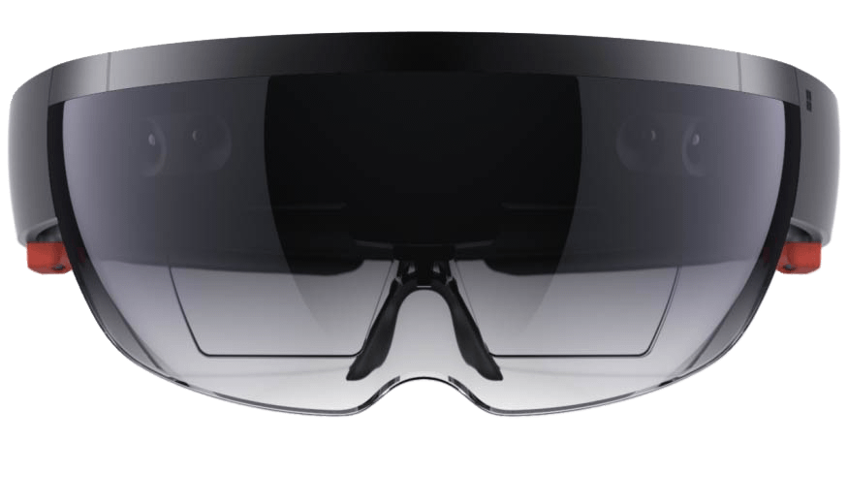
A little about me
June Cho
Enterprise Mobile App Developer
juc@microsoft.com
www.linkedin.com/in/chojune/

Slide 2





Visual Studio App Center
Continuous Everything – Build, Test, Deploy, Monitor, Repeat.

Slide 3




Businesses are rapidly appifying
Silicon Valley is coming. We are going to work hard to make our services as seamless and competitive as theirs.
“
We are putting 70% of our applications in the cloud to improve flexibility. And, we are launching truly game-changing applications to improve efficiency.
“
Walmart is re-defining the next generation of retail growth and is the best-positioned retailer to win at the convergence of digital and physical retail.
“
It's about looking ahead to the changes coming to the automobile business, particularly from potential ‘disruptors’ in Silicon Valley - and preparing Ford to thrive through those changes.
“
Jamie Dimon CEO, JP Morgan
Jeffrey Immelt CEO, GE
Doug McMillon CEO, Walmart
Mark Fields CEO, Ford Motor Company
Notes:
Disruption affects every industry and no company is safe.
Half of the companies that were on the Fortune 500 in 2000 are now gone, replaced by organizations that deliver value faster, better, and cheaper – and the current Fortune 500 faces very much the same fate.
Technology plays a central role in the disruptors‘ ability to execute better.
But it’s no longer just the unicorns that disrupt – increasingly, companies you might not associate with the cutting edge of IT have recognized they need to invest in new technology.
‘Traditional’ companies are using cloud technology and investing in mobile to stand out.
To future-proof their business, we see enterprises embracing innovation and new ways of working to mitigate threats from newcomers.

Slide 4

Businesses create a multitude of apps
CUSTOMER APPS
SUPPLIER APPS
EMPLOYEE APPS
Customer Service
Product Info
My Account
Purchases
Loyalty
Orders
…
Order Management
Procurement
Dashboards
Inventory
Resellers
ERP
…
Health Services
Onboarding
Recruiting
Benefits
Payroll
Travel
…
Notes:
Many businesses have already started their journey to mobile with consumer apps some time ago, so they are familiar with some of the biggest challenges.
When the iPhone came out there was ‘an app for that’.
And now the same thing is happening across every aspect of the modern business.
Businesses are realizing that in order to be successful and thrive they will have to support not just one mobile app but a multi-app mobile strategy.
We call this the appification of modern business – the proliferation of targeted, highly optimized apps designed for a particular group of users or specific task or purpose.

Slide 5
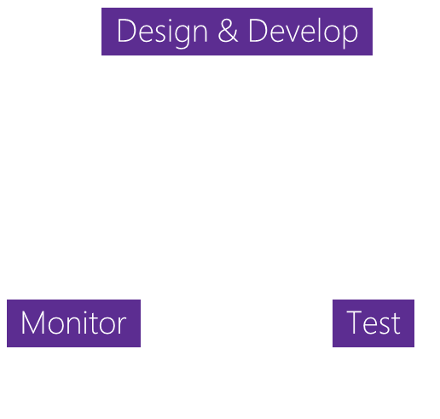

App development challenges
SCALE
COMPLEXITY
FRAGMENTATION
Design & Develop
Monitor
Test
100+ apps
Businesses need to rapidly build and deliver high-quality mobile apps
App Delivery
The lifecycle to deliver ‘just one’ app involves many stages
1000+ Devices
Mobile ecosystems are complex with many combinations of devices
Notes:
Many companies have built their first few apps, but those numbers are growing. As one app turns to tens or hundreds this introduces greater complexity to the development process as companies look to not only maintain the apps they have, but also introduce new ones.
Additionally, as companies look to create these applications, they still need to consider what devices their users have, and it can be extremely difficult to develop for all those different possibilities.

Slide 6



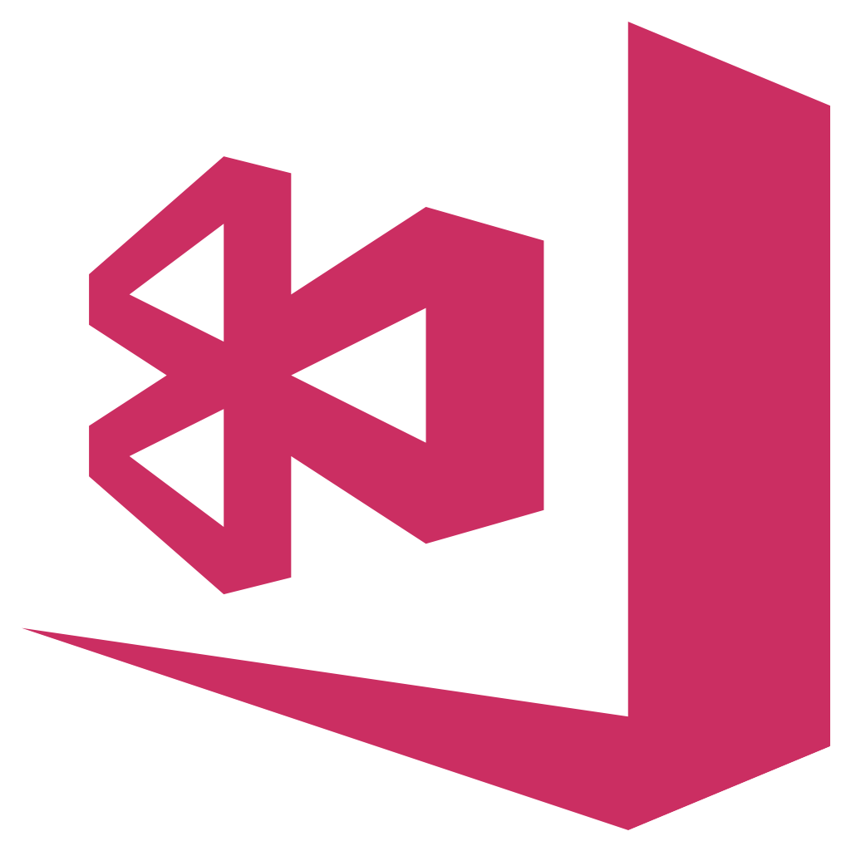
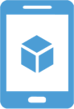

HockeyApp
Xamarin Test Cloud
Xamarin Insights
Distribution • Crashes • Analytics
Device Tests
Crashes • Analytics
Visual Studio App Center
Azure Mobile Engagement
Azure App Service
CodePush
Analytics • Push
Tables • Auth • Push
Distribution
Notes:
Talk about how our teams and product came together.
Here at Microsoft we offer services like HockeyApp for distribution, Xamarin Test Cloud for automated device testing and Azure Mobile Engagement for targeted push notifications. As we saw managing multiple applications can become unwieldy, we took these Microsoft products and brought it all together creating Visual Studio App Center.

Slide 7
Visual Studio App Center
Continuous integration, delivery and feedback for iOS, Android, Windows, and macOS apps.
Ship 5-star, higher-quality apps faster with confidence.
Notes:
Visual Studio App Center is your continuous integration, delivery and learning solution for Android, iOS, Windows, and macOS apps. A place where all these service seamlessly integrate to make the cycle easier and faster for developers. You now have an end-to-end solution where you can either use all the services offered or pick and choose the ones you want.

Slide 8
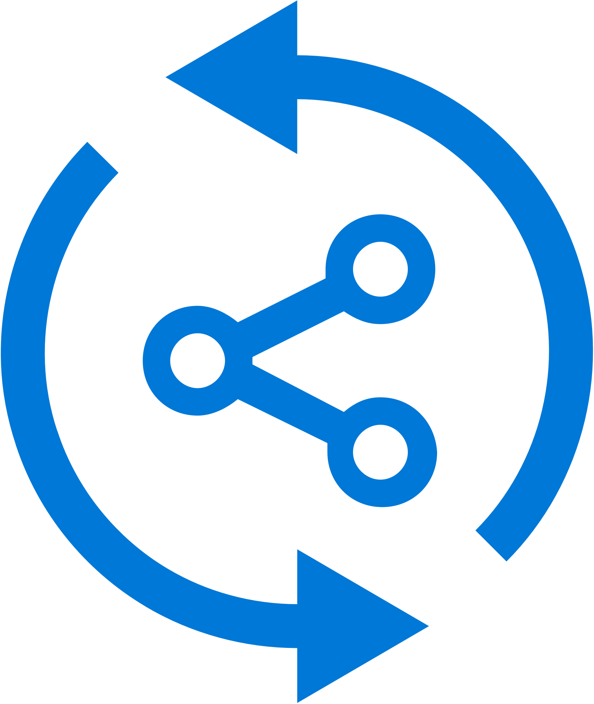


Continuous integration in minutes
Build-on-push
With just a few steps automatically build apps with every commit, and generate packages to test and distribute
Work with existing tools
Connect existing repositories in GitHub, Bitbucket, and Visual Studio Team Services with just a few clicks
Build securely in the cloud
Each build is run on a separate, clean virtual machine hosted on our secure cloud servers
Notes:
The Build functionality allows you to connect your existing code repositories, like VSTS, GitHub and BitBucket and configure them to run automatically on code submission, or on a timed schedule, regularly staying up to date on the health of your build. This is all done on the cloud, so you don’t have to manage any hardware locally.

Slide 9


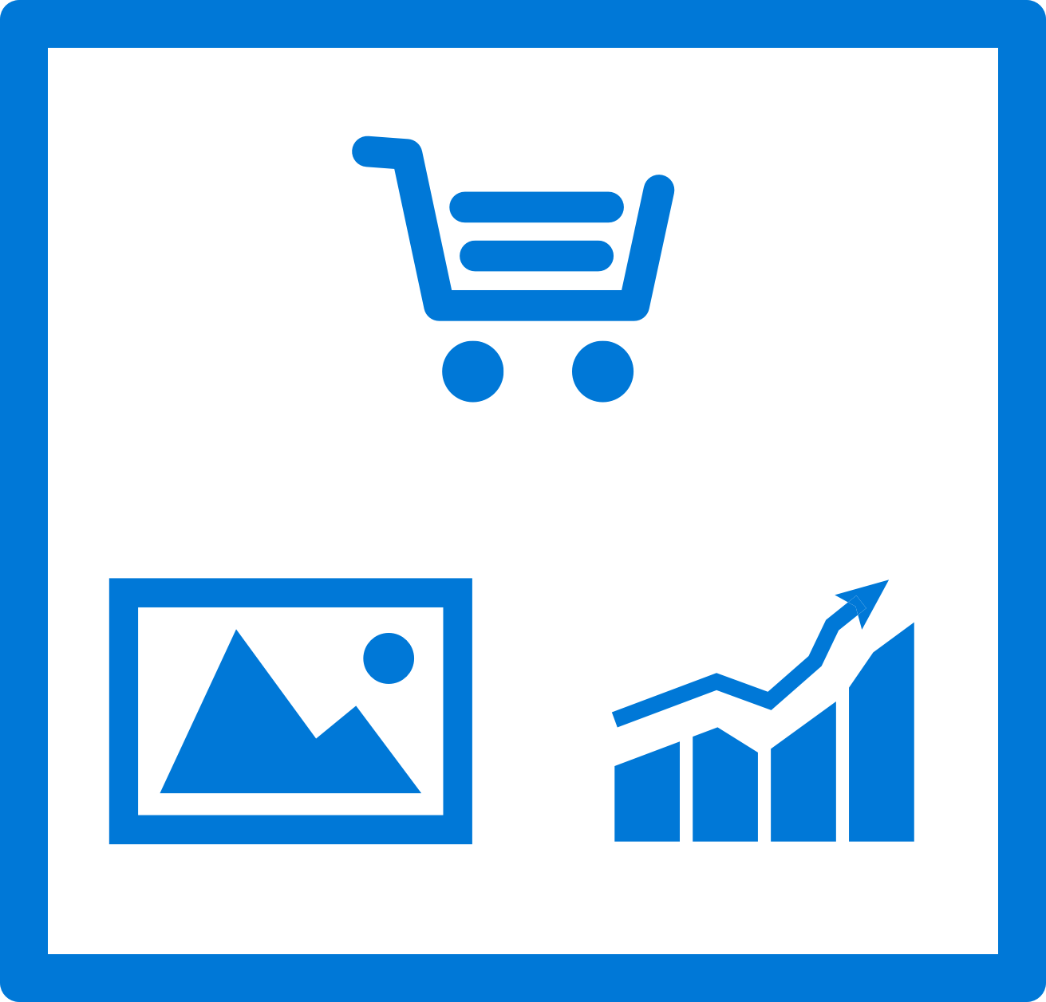
Continuous quality on real devices
Release faster
Shrink release times significantly and push new apps out faster
Ship high-quality apps Ensure the highest quality user experience that keeps users continuously engaged
Engage a broad audience
Test on a broad range of devices to make sure apps work on your users’ devices
Create new features Spend less time fixing bugs, and more time creating value
Notes:
App Center’s testing solution starts with our device lab with over 300 configurations and thousands of individual Android and iOS devices that you can run your developed UI Automation scripts. We support scripts written in a variety like UITest, Appium or the native Espresso and XCUITest. Run your app on real devices without, again, maintaining the hardware, and getting live results to know your app is bug free.

Slide 10
Get Started Free Today aka.ms/vsappcenter

Slide 12
Azure Serverless and Functions Overview
Dan Rigby
Technology Solutions Professional
Twitter: @DanRigby

Slide 13
What is Serverless?

Slide 14
The evolution of application platforms
On-Premises
IaaS
PaaS
Serverless
Notes:
All good things begin with a story.
So before I talk to you about serverless, I wanted to discuss some history of how apps have been built through the years and how that has led us to the computing options we have today.

Slide 15
What is the right size of
servers for my business needs?
How do I deploy new code to my server?
What media should I
use to keep backup?
What happens in case of
server hardware failure?
Which packages should be on my server?
What size of servers
should I buy?
Who monitors
my App?
How often should I backup my server?
How can I scale my app?
How can I increase server utilization?
Who has physical
access to my servers?
Which OS should I use?
Do I need secondary network connection?
Are my server in a
secure location?
What happens if the
power goes out?
Who monitors
my Servers?
Do I need a UPS?
What storage I need to use?
How many servers
do I need?
How can I dynamically configure my app?
It takes how long to provision a new server?
How often should
I patch my servers?
On-Premises
The “evolution” of application platforms
Notes:
On-Premises
Buy your own hardware and software
Run it in your own data-centers
Deal with a multitude of questions
# of servers
Physical security
Hardware failure
Software patching
Backup
Essentially a lot of questions, not all of which might be directly related to running your business.
For example, if you are running an insurance company, you want to spend your time growing and innovating in the insurance domain, not worrying about how to handle servers.

Slide 16
What is the right size of servers for my business needs?
How can I increase server utilization?
How many servers do I need?
How can I scale my app?
How often should I patch my servers?
How do I deploy new code to my server?
How often should I backup my server?
Which OS should I use?
Which packages should be on my server?
Who monitors my App?
On-Premises
IaaS
The “evolution” of application platforms
Notes:
Along came the cloud, and provided some relief from some of those questions.
IaaS in the cloud, allowed you to forget about managing all that physical hardware. Instead of hosting it yourself, you could now utilize servers hosted by someone else.
While the worries around managing physical infrastructure are gone, there are a number of questions that still need to thought about:
How many virtual machines do I need?
How many would I need in future when my usage grows?
How to handle updating the servers for the latest security patches
How to think about deploying my code and the various dependencies, such as application runtimes, to the server
Who monitors my apps and so on
This means that you still haven’t reached that ideal state where you could focus purely on your business and its problems.

Slide 17
What is the right size of “servers” for my business needs?
How can I increase “server” utilization?
How many “servers” do I need?
How can I scale my app?
On-Premises
IaaS
PaaS
The “evolution” of application platforms
Notes:
Well, the cloud continue to help with that problem and with the advent of PaaS, there was even more simplification.
PaaS allows you to just worry about your app, and let the cloud vendor take care of not only the physical hardware, but also the ongoing management of the operating environment like Operating Systems, Virtual Machines or Containers, as well as the various application runtimes, whether it is Java Runtime, .NET, Node.js, and so on.
You are not completely free from thinking about servers however, since you still have to worry about how to scale your app and accordingly specify the number and size of the various compute resources your apps would need at various times.

Slide 18
How do I architect my app?
Serverless, the platform for next gen apps
On-Premises
IaaS
PaaS
Serverless
The “evolution” of application platforms
Notes:
The latest in this series of evolution is Serverless – which further abstracts the underlying infrastructure from you, and allows you to focus only on a single question – how are you going to build your app to achieve the best results for your business, or whatever it is that you are trying to do with your apps.
Whether it is the code to delight your customers through a great experience, or the logic to communicate securely with a business partner, that is where most organization want to spend their creative energies on.
And serverless allows you to do just that, focus on your code and forget about the infrastructure.
This is why we believe it is the platform for next generation of apps.

Slide 19
What is Serverless?
$
Abstraction of servers
Event-driven/ instant scale
Micro-billing
Notes:
Abstraction of servers:
Complete freedom from thinking about provisioning, maintaining or scaling any server or infrastructure aspects
Event-driven/instant scale:
Ability to handle any volume of traffic without explicit configuration
handle sudden jump from 0 execution to tens of thousand of executions seamlessly
Micro-billing:
Paying only for what you use
You pay only for the amount of time your code runs and the amount of resources it consumes during that period
Never pay for idle capacity

Slide 20
Benefits of Serverless
Manage apps not servers
Reduced DevOps
Faster time to market
Notes:
Manage apps not servers:
Focus on your app logic. If you are an insurance company, you want to be spending your time on providing a great customer experience and maybe optimizing the claims approval process.
You don’t want to worry about servers. It is now possible
Reduced DevOps:
Since you are no longer required to worry about scale, availability, deployment etc., your effort towards non-core activities goes down significantly
Serverless architecture leads you down something we call a “pit of success” by providing a model where components are small and decoupled by design thereby reducing integration challenges
Faster time to market:
Time saved leads to faster app building
Serverless also provides an easy and cheap way to do experimentation – thereby allowing for faster iterations and prototypes

Slide 21
Serverless application platform components
Functions
Execute your code based on events you specify
Notes:
Now the concept that I want to talk about next is that of a platform, not an individual service, but a collection of fully managed services that come together and allow you to build serverless applications.
When we talk about serverless, the first thing that obviously comes to mind is Functions-as-a-Service. Basically the ability to execute custom code, on demand, without having to worry about where the code is executing, or how it would scale if the demand goes up.
This is what Azure Functions does for you. We will go into details later but that is the basic thing to remember.

Slide 22
Serverless application platform components
Logic Apps
Functions
Design workflows and orchestrate processes
Execute your code based on events you specify
Notes:
Now let me talk about Logic Apps. How many of you have heard about Logic Apps? This service was actually introduced before Functions. And I want to talk about why this service is an important part of the serverless story.
Imagine you are drawing a flowchart that represents a certain process in your business. For example - when a new customer record is created in my CRM system, go ahead and create a project in my project management system, and then send a notification email to these 3 people. We need to have processes like these all the time.
What if you could easily convert these flowcharts into real applications that actually do those things?
Azure Logic Apps effectively does that for you. Through a visual design experience, you can create workflows, that could have multiple steps. And each step could be performed by a different first party or 3rd party service, or even an Azure Function that you might have written.
And goes without saying that you don’t have to worry about where all of this processing is happening – a server, a VM, a container or whatever else. You focus only on the what, not on the how.
In a way this experience is not only serverless, but from a user’s perspective, it is often code-less.

Slide 23
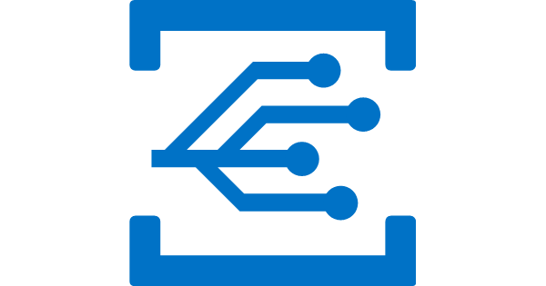
Serverless application platform components
Event Grid
Logic Apps
Functions
Manage all events that can trigger code or logic
Design workflows and orchestrate processes
Execute your code based on events you specify
Notes:
Now lets talk about Event Grid, the latest entry in our serverless toolkit.
If you think about it, in many ways the popularity of these instant scale, pay as you go compute services can be attributed to the fact that modern computing is all about events. And these events need to be responded to. Whether it is IoT devices sending signals to a central location, users performing some actions on their mobile apps, or even some systems communicating with each other. All of these are examples of event-driven scenarios in which there are certain events that need to be processed.
But how do we manage all these events? This is where Event Grid comes in. This service makes it super easy by providing a single simple interface for managing all your events.
Things like:
Where these events are coming from – whether it is a storage change, a database change, a resource being provisioned, or a new user being added to your subscription
And where these events are headed to – whether you need to invoke an Azure Function or an Azure Logic App to respond to this event, or even some other destinations.
We believe that for modern apps an event is an important enough entity that we should make it a first class citizen of Azure, and take away the burden of managing events in either producers or consumers of these events.
This is what Event Grid does.

Slide 24

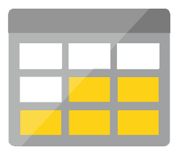
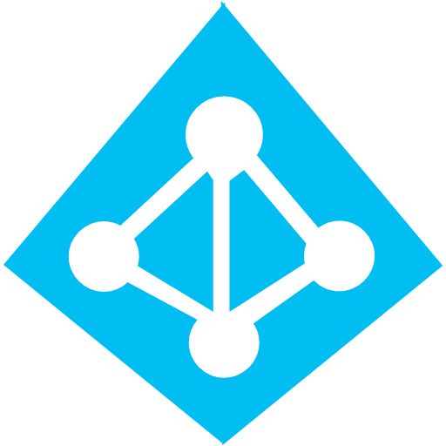
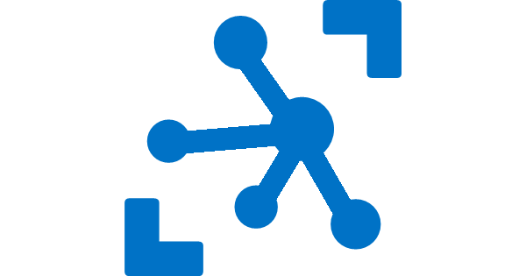

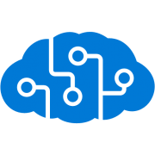
Serverless application platform components
Platform
Event Grid
Logic Apps
Functions
Manage all events that can trigger code or logic
Design workflows and orchestrate processes
Execute your code based on events you specify
Database
Storage
Security
IoT
Analytics
Intelligence
Notes:
OK now that we have the basic building blocks of serverless computing – what do you want to do next?
We are building applications after all. And applications don’t exist in vacuum. They talk to databases, they enable authentication for their users, if it is an IoT app, it potentially receives data from and sends data to IoT devices. Maybe they need to process that data to prepare it for further analysis, and more and more applications these days are required to have some kind of intelligence in them.
How do we achieve these things in our apps? It wouldn’t be fun if our application code was running in a serverless environment but we still had to manage an army of Virtual Machines to perform these other tasks.
We need serverless services for serverless apps. And this is what Azure provides us – we have Cosmos DB, a globally distributed, elastic scale database, a perfect ally for your serverless apps. We have Azure Active Directory (AAD) and AAD B2C for your security and access control needs, IoT Hub solves your IoT needs.
We have services like Event Hubs and Stream Analytics to ingest and analyze real-time streaming data. Lastly, we have the Microsoft Cognitive Services API to provide intelligence in your apps.
All of these services together comprise the Azure Serverless application platform. Using these pieces you can compose applications that work at any scale.

Slide 25

Serverless application platform components
Development
Platform
IDE support
Event Grid
Logic Apps
Functions
Manage all events that can trigger code or logic
Design workflows and orchestrate processes
Execute your code based on events you specify
Integrated DevOps
Local Development
Monitoring
Database
Storage
Security
IoT
Analytics
Intelligence
Visual Debug History
Notes:
So we have a platform now. But how about the process of building these applications? What does the developer experience look like?
Azure is a platform built by Microsoft, and if there is one thing we do right – it is the developer experience. Even in the cloud world, we don’t subscribe to the mentality that just because you are reaping the benefits of running application in the cloud, you can be subjected to pain and heartburn while building those apps.
So for serverless apps, we provide full end to end development experience through tools like Visual Studio and VS Code. We in fact support unique features like the ability to build, test and debug your applications locally on your dev machines, before even deploying them to the cloud.
This is a massive productivity boost while building cloud apps and something no other cloud vendor can match. These technologies support continuous deployment so you can easily integrate them into your existing deployment pipelines. And finally, we provide full monitoring support through Azure Application Insights to monitor your apps in production.
So that is how we think of a comprehensive serverless application platform in Azure.

Slide 26
Scenarios for Serverless
Anything that needs to respond to events
Real-time stream processing
Timer-based processing
Millions of devices feed into Stream Analytics
Transform to structured data
Store data in SQL DB
Every 15 minutes
Find and clean invalid data
Clean table
Backends (Mobile/IoT/Web)
Real-time bot messaging
?
...
Photo taken and WebHook called
Stores in blob storage
Produces scaled images
Message sent to Chatbot
Chatbot sends
response
Cortana Analytics answers questions
Notes:
So what kind of apps and scenarios can be built using serverless technologies?
Anything where there is need to run some code or logic in response to an event. You will notice that this is a very broad definition and covers a vast array of scenarios.
So let me provide some examples:
Real-time stream processing: IoT devices sending data that needs to be analyzed, enriched and archived somewhere. This is best done using serverless functions which can be spun up on demand, because you don’t know when the data is going to come in and how much data is going to come in. So, you don’t necessarily want to build your own infrastructure for peak capacity.
Almost every organization needs to run some regular tasks like de-duplication of database entries at the end of every day or collecting logs at the end of every week. Such tasks that need to be run only at specific times and only for a few seconds each time, don’t call for dedicated infrastructure. They are best left to serverless solutions.
Building backends for your mobile, IoT or even web apps is also a popular use-case for serverless architectures: In this diagram you see a mobile app sending an image to a function which stores it in Azure Storage. This action triggers another function which creates multiples thumbnails out of the original image. Being able to perform these action in a serverless manner, takes away the burden of the mobile developer from worrying about the backend.
Bots are all the new rage: An Automated response system receiving a customer request is an event. Building intelligent bots for such scenarios using serverless technology is again a great example where the focus needs to be on logic instead of infrastructure.
These are only some of the many examples which fit well with serverless.

Slide 27


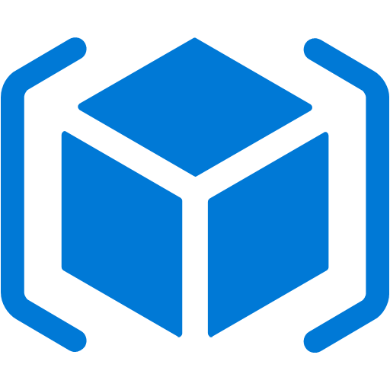

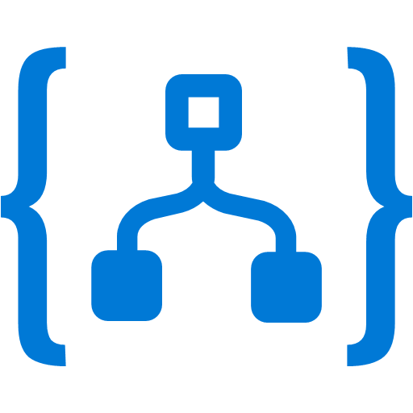


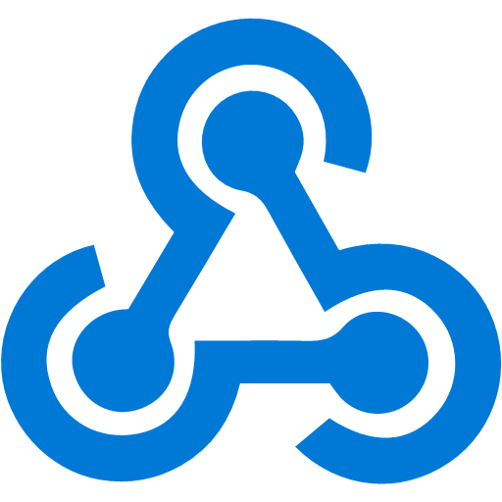

Event Grid
Event publishers
Event handlers
Manage all events in one place
Unlock new scenarios for your apps
Ensure reliability and performance for your apps
Blob Storage
Azure Functions
Resource Groups
Logic Apps
Azure Subscriptions
Azure Automation
Event Hubs
WebHooks
Custom Events
Notes:
Now, I would like to describe the capabilities of our core serverless services, in a little more detail, this time starting with Azure Event Grid.
We already talked about how important events are.
This service allows you to manage all events in a single place
Notice that multiple Azure services today publish their events into Event Grid and these events can be routed to multiple destinations. We have Functions, Logic Apps and even other services like Automation and generic webhooks.
You can also create your own custom events
The rich set of publishers and consumers opens up many interesting scenarios for you to construct already. And the list of services that will publish their events to Event Grid will continue to grow over time.

Slide 28
Event Grid delivers at massive scale
Sub-second end-to-end latency in the 99th percentile
10,000,000 events per second per region
24-hour retry with exponential back off for events not delivered
Near real-time
Massive scale-out
High reliability
Notes:
In terms of performance and scale, Event Grid makes some strong guarantees.
Sub-second end to end latency in the 99th percentile, which is as close to real-time delivery as it gets
An ability to route about 10 million events per second, so massive scale
And, an intelligent logic to retry the event delivery if the first time doesn’t succeed
All of these make Event Grid a very powerful event backbone for your serverless applications.

Slide 29
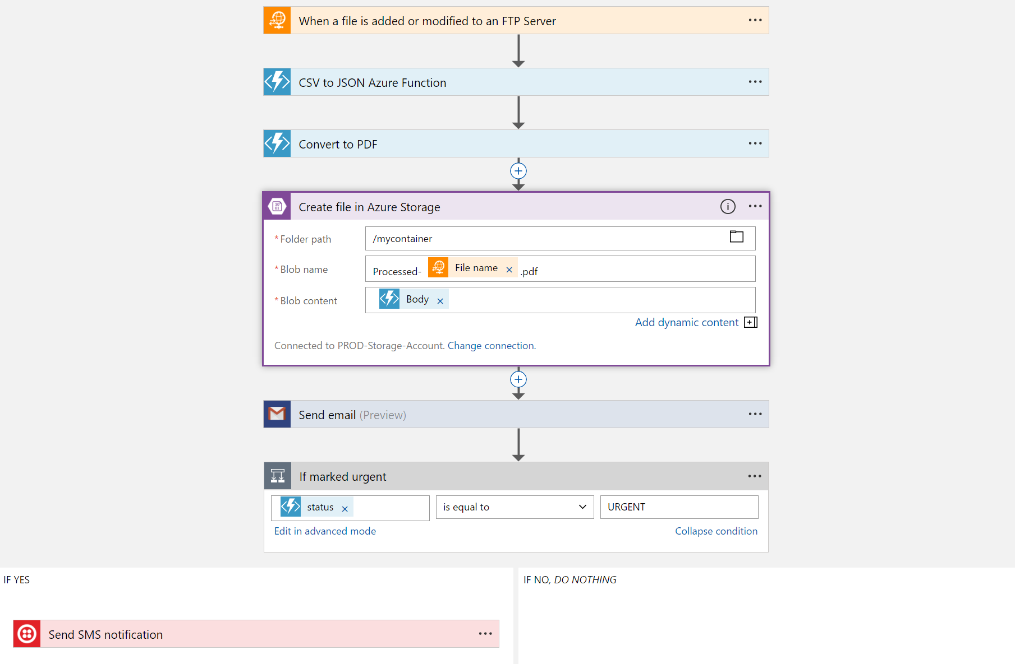
Logic Apps
Visually design workflows in the cloud
Express logic through powerful control flow
Connect disparate functions and APIs
Utilize declarative definition to work with CI/CD
Notes:
Moving on to Logic Apps
Logic Apps is a service that provides a visual design experience for creating serverless workflows in the cloud without writing any code.
No matter how complex your business logic is, you can express it using the powerful control flow available in Logic Apps.
Another key value of this service is that, it provides connections with multiple services and allows you to orchestrate all these services along with the functions which you or someone else in your organization might have written.
Lastly all of these workflows are internally represented using a declarative definition format, again making it very friendly with your existing CI/CD practices

Slide 30
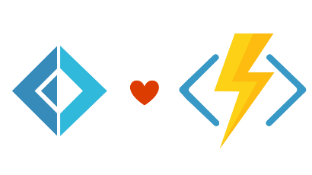


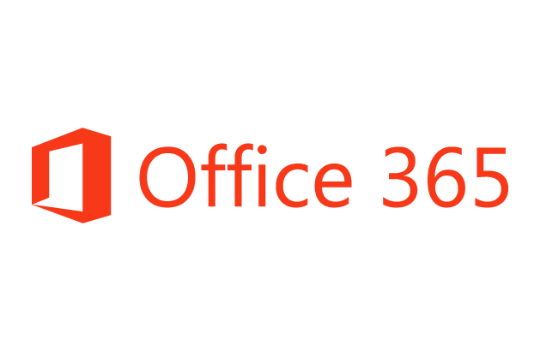
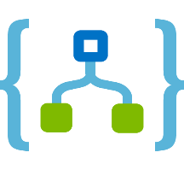
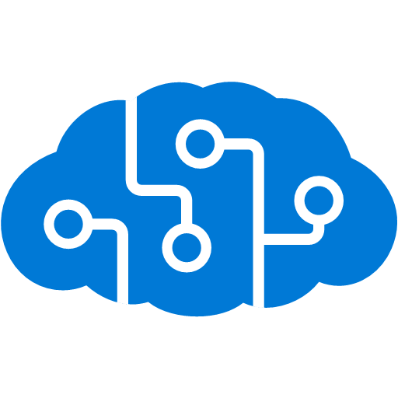
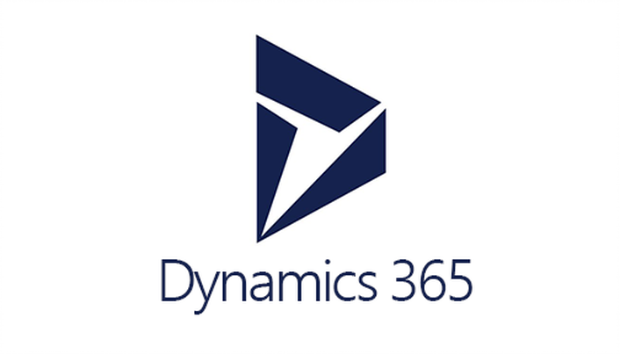



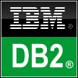
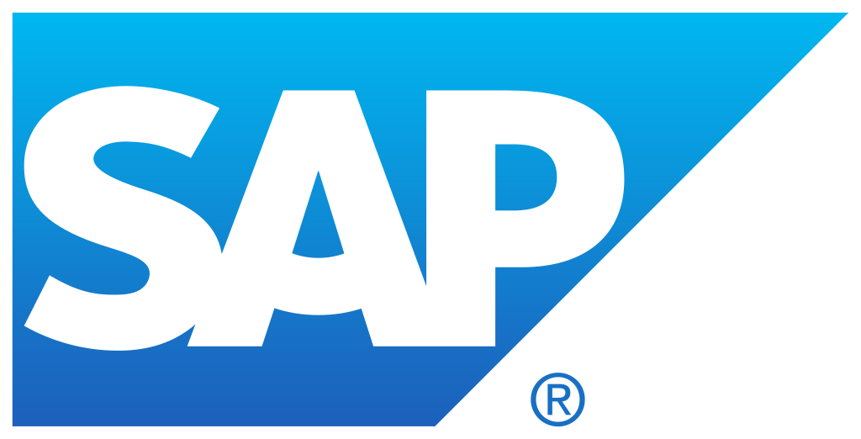


Logic Apps connects everything
Azure Functions
Service bus
Cognitive services
Logic Apps
Machine learning
On-premises data gateway
BizTalk server
Notes:
Logic Apps can integrate with almost anything (APIs) and solve small or complex problems. Automation in a secure and reliable environment fast and easy.
Connect Anything:
On-premises, hybrid and cloud
Mission critical, complex integration scenarios
Business productivity
Agile Business:
Quickly create workflows
Position to the future API centric
Transform Business:
Extract value from both (on-premises and cloud apps)
Build Holistic integration solutions.

Slide 31
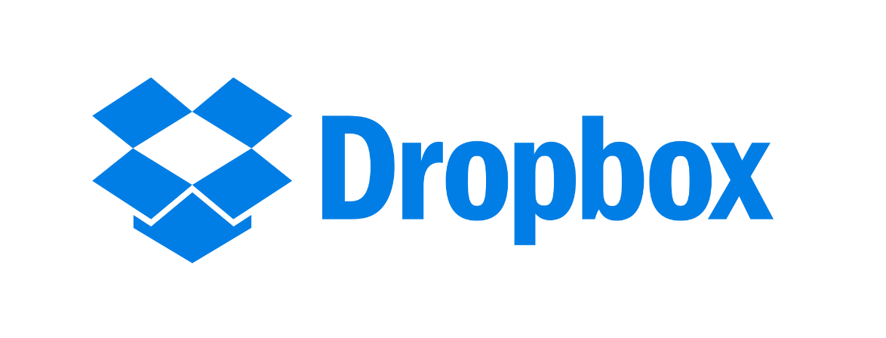

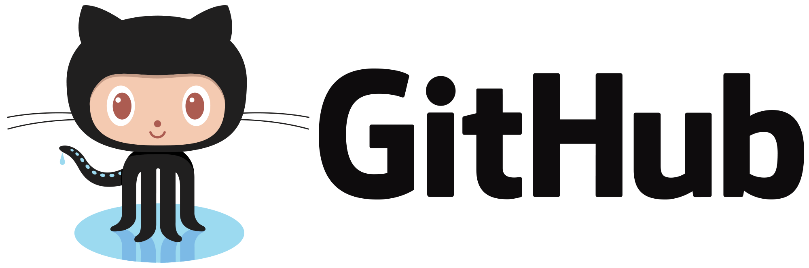
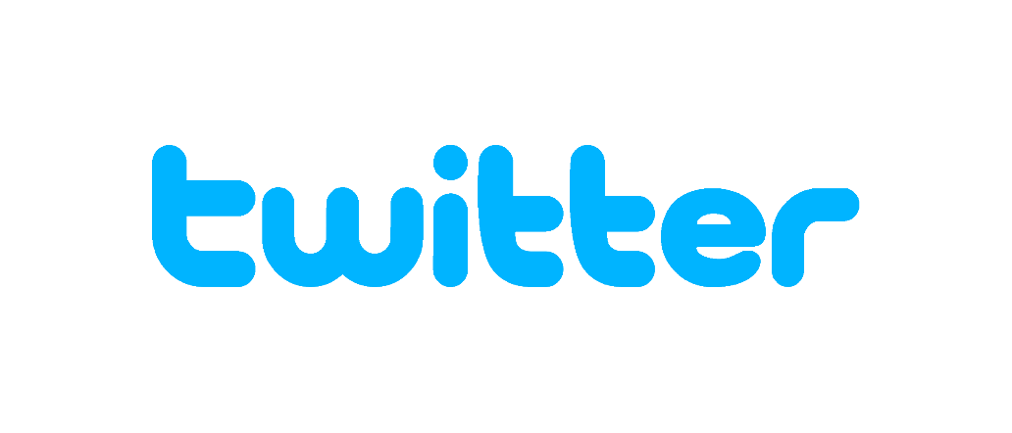
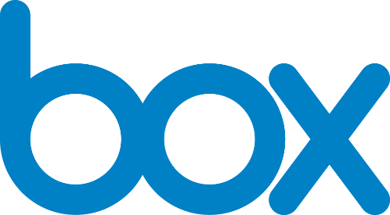

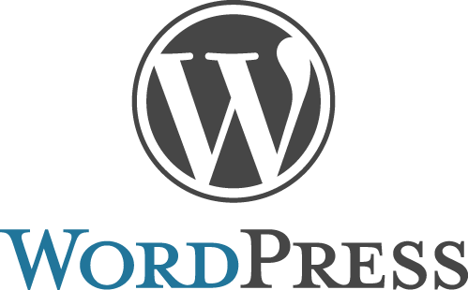
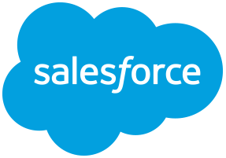
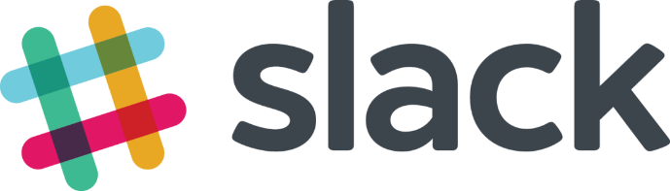
Logic Apps connectors—Over 170 and growing
….and more!
Notes:
Logic Apps support more than 170 connectors already. It goes without saying that it supports most Azure services but you can see from this list that it also supports many popular 3rd party services like Dropbox, Twitter, Salesforce and so on.
And it does that without requiring you to understand how any of these other services work. It completely abstracts the integration details of how to communicate with these other services and their specific API, SDKs and protocols.

Slide 32
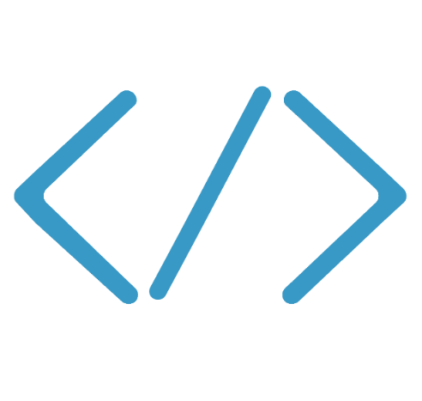

Functions
Code
Azure Functions
Events & Data
Develop locally using best of class developer tools
Boost productivity through triggers and bindings
Choose from a variety of programming languages
Integrate with existing DevOps processes
Notes:
We already saw how Functions provide an experience of responding to events through code that in turn processes data that could be coming from or headed to any number of services.
Some of the key highlights are:
Ability to build, test and debug your Functions code locally on your own machine before your code is even deployed to the cloud. This is a massive productivity benefit while building cloud applications and something Azure provides through rich integration with a world class developer tool like Visual Studio
Secondly, unique features like triggers and bindings that make it super easy to setup event-driven architectures and simplify communication with data sources
Thirdly, we support a large number of programming and scripting languages. This includes Bash, Batch, C#, F#, JavaScript with Node.js, PHP, Python, PowerShell, and TypeScript so you can pick the language of your choice to write serverless functions with.
Lastly, Functions support concepts such as Continuous deployment, which makes it super easy to integrate them into your existing DevOps pipelines.

Slide 33
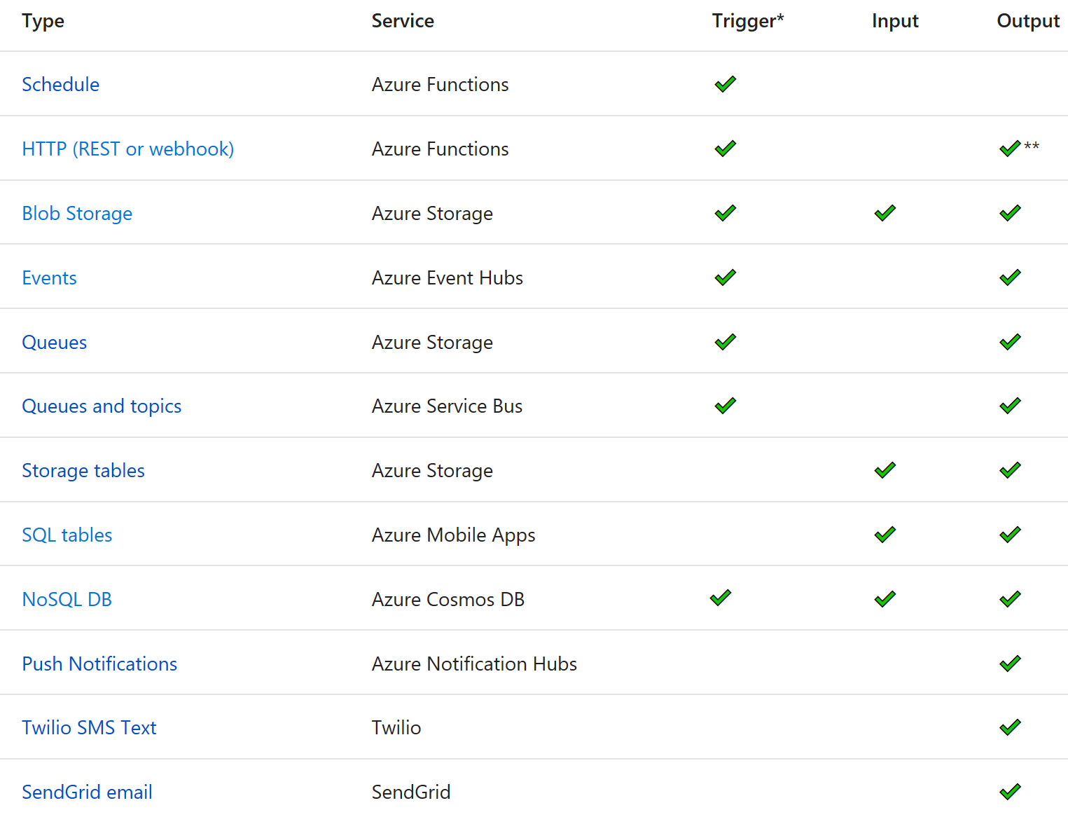
Functions triggers and bindings
Notes:
As I mentioned earlier, triggers and bindings are the things that facilitate easy communication with other services.
This chart shows us the triggers and bindings currently supported.
As we can see, there are a number of Azure services supported here…. for Storage, Database, Messaging, Notifications and so on.
In addition to those, Functions also supports generic Http triggers, which means you can easily write a piece of code that can be used to respond to REST requests or requests from any service that supports webhooks.
This also provides a really fast and easy mechanism for building extensions to SaaS applications.
We are fully committed to making this list grow and making more check-marks appear in that table.

Slide 34

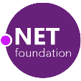
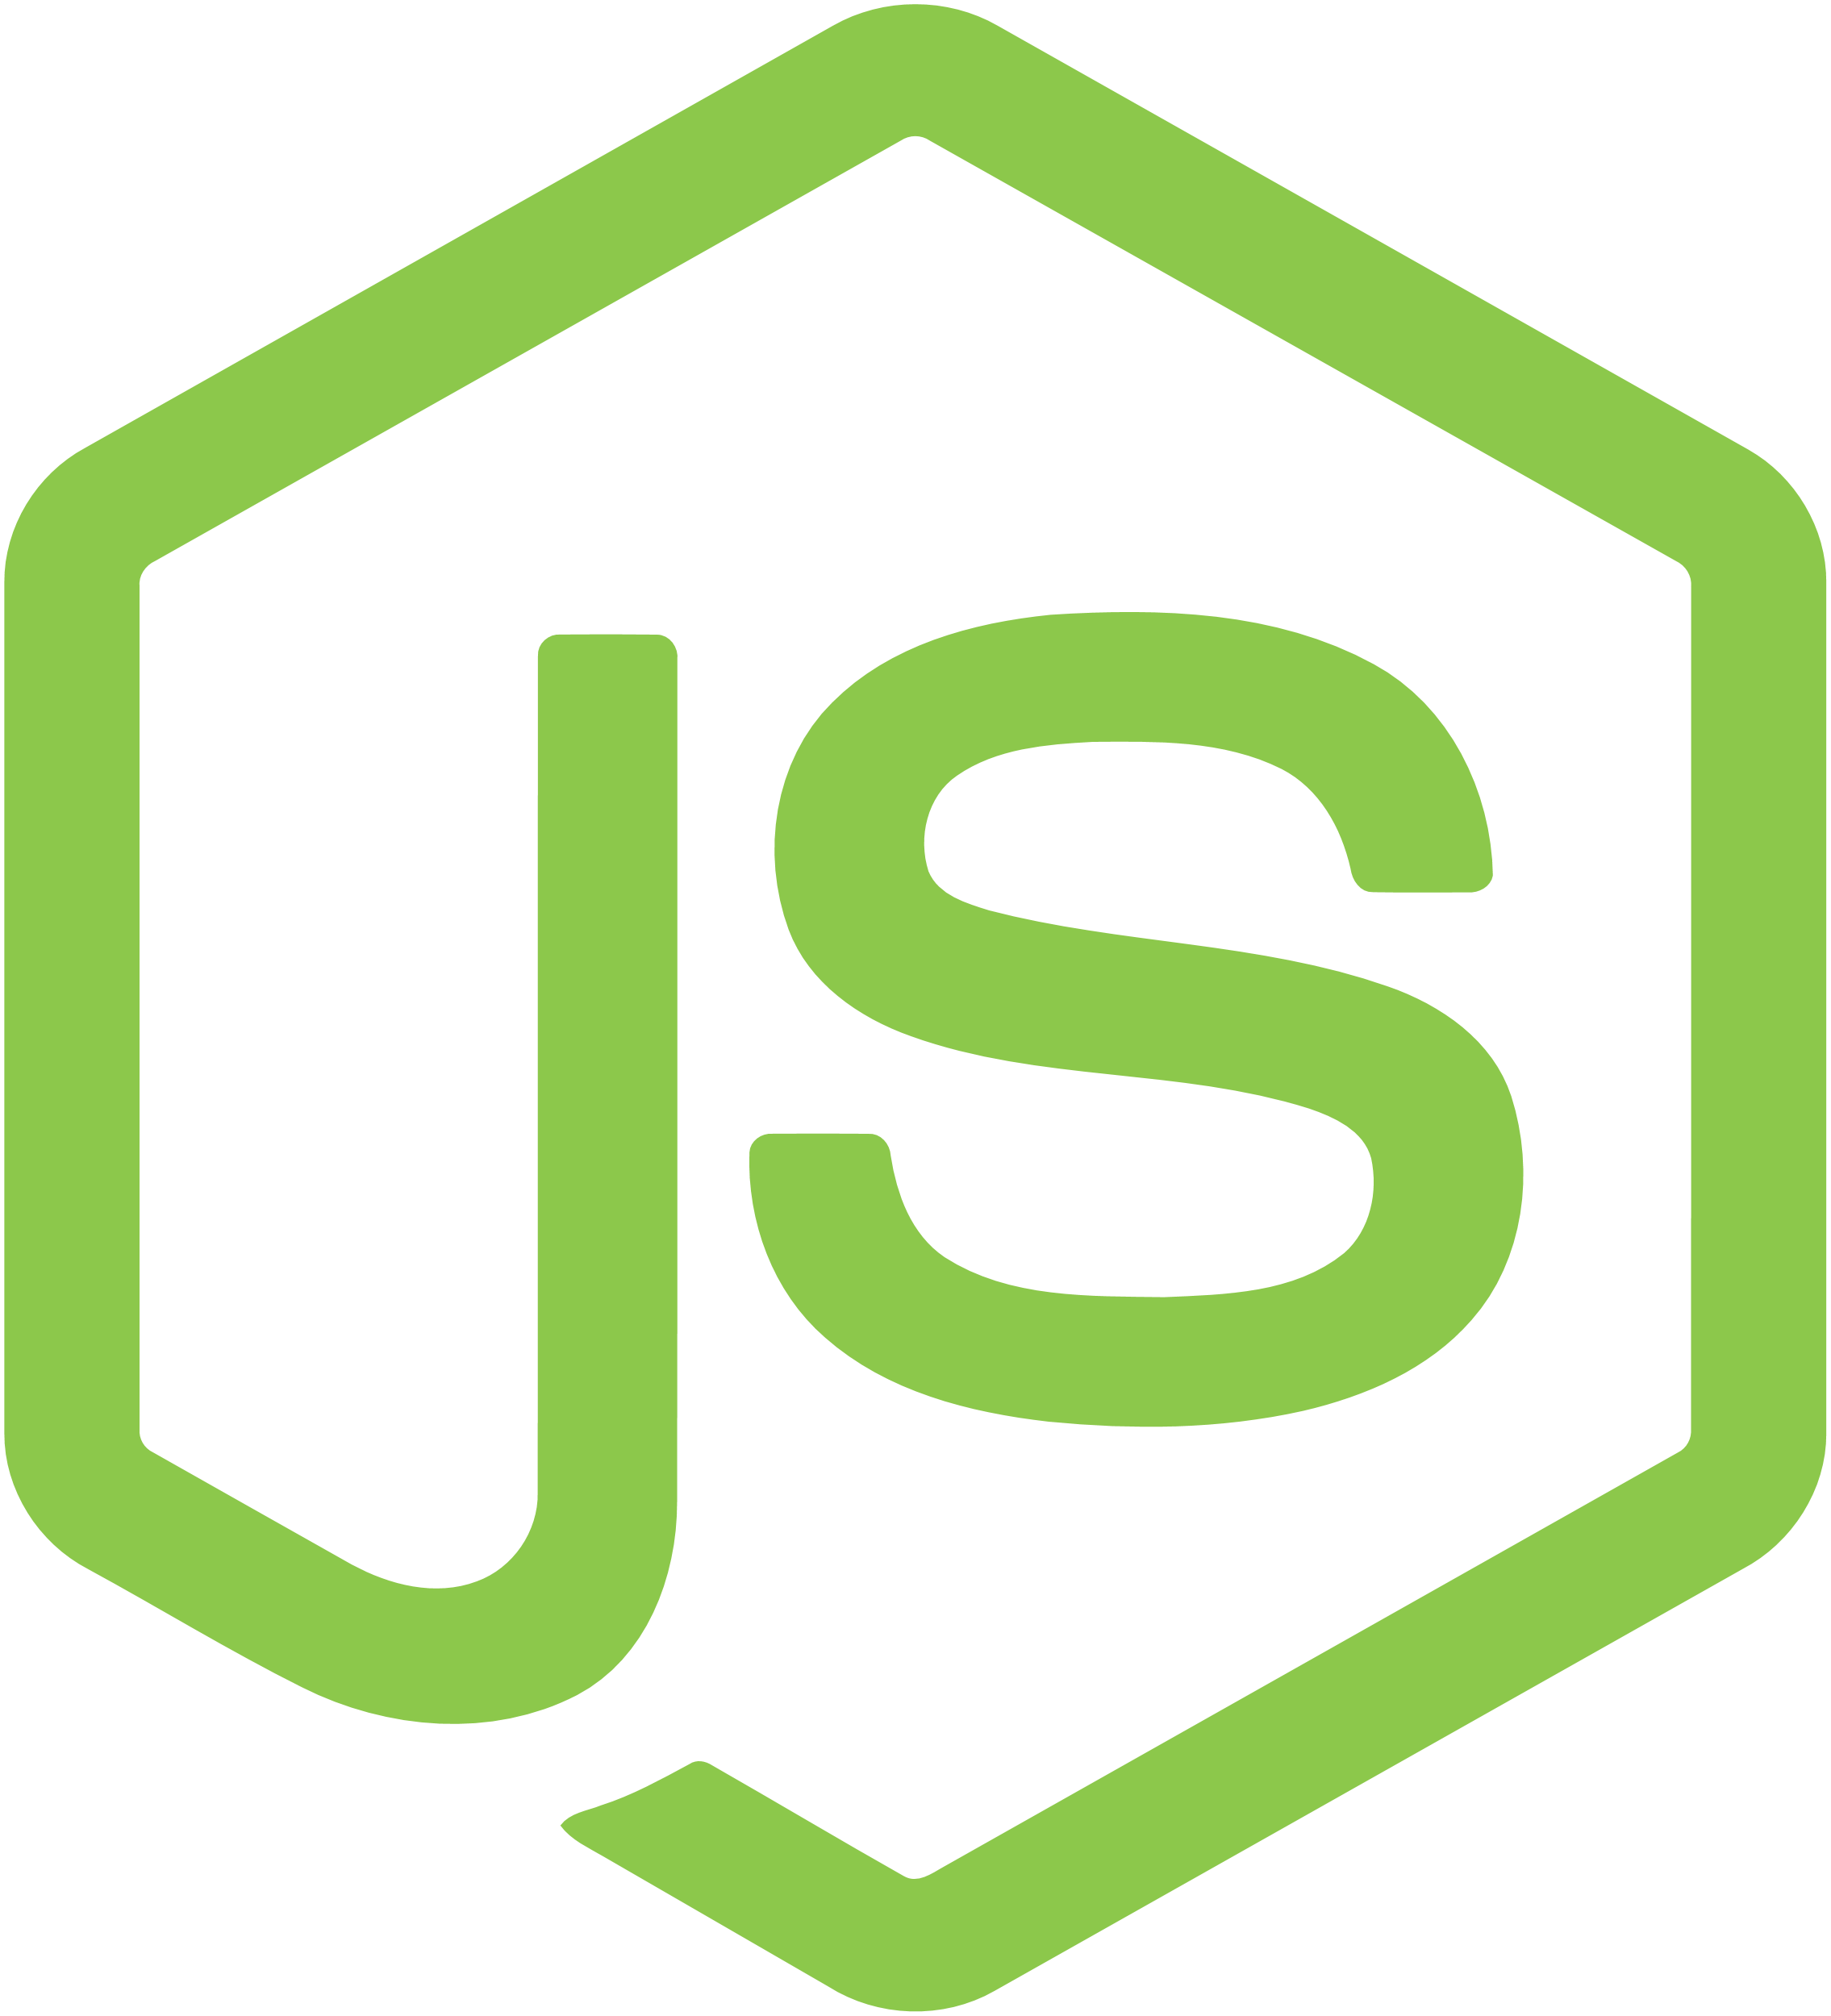



Azure Functions platform features
Development
Languages
Platform
IDE support
.NET
API Features
Visual debug history
Node.js
Bindings
Local development
Scripting (PowerShell, Bash, Batch, Python, PHP)
CI/CD
Verbose debugging
Java
App Service
Notes:
Lets talk about what really makes up MSFT’s Serverless platform: At the center of the Serverless platform, is our compute offerings: Azure Functions and Azure Logic Apps. Azure Functions is an event based Serverless compute experience that helps you accelerate your development. Run time is open. Function code can be executed in vm or somewhere else, on prem or in clould. Logic Apps is a powerful orchestration tool. It enables building a Serverless app in minutes – by orchestrating multiple functions using a visual workflow tool.
Say you have your apps up and running using Serverless. Congratulations! You now need to collect intelligence from different apps across platforms to take actions upon. There are a few essential components which we think are core to building Serverless applications are:
Data/ Storage –Functions has triggers and bindings with Azure document DB and Azure Blob storage
** Triggers: Triggers are event responses used to trigger your custom code. They allow you to respond to events across the Azure platform or on premise.
** Bindings: Bindings represent the necessary meta data used to connect your code to the desired trigger or associated input or output data.
Messaging such as queues and topics using Azure Service Bus and Azure Event Hubs
Integration – that includes core LOB apps and SaaS apps integration via Azure Logic Apps.
Intelligence on data and sentiment/ predictive analysis using Cognitive services and Machine learning
Conversation as a service – how do we equip developers to build apps that offer an end-to-end experience for their end users – Azure Bot Service offers a Serverless interactive bot experience.
More, developers are spending more time writing code that allows them to add huge business impact with Serverless. MSFT offers numerous development tools such as IDE Support for Visual Studio in functions and Logic Apps, enables local development (vs web browser coding environment), visual debugging capability, all with your tools of choice.
Lastly, I also want to highlight top scenarios and use cases for Serverless:
Real-time Stream analytics: Customers can use Functions to feed real-time streams of data from application tracking into structured data and store it in SQL online.
SaaS event processing: Customers can use Functions and Logic Apps to analyze data from an excel file in Onedrive and perform validation, filtration, sorting and convert data into consumable business charts
Web app architecture: Used a lot in creating targeted marketing collaterals – when a customer clicks on a webpage, it triggers a webhook, that uses a function to create an ad that matches the customer profile and displays a completed webpage.
Real-time bot messaging: When customers send a message to a chatbox, Functions calls Cortana analytics to generate appropriate answers and sends a response back.

Slide 35

What’s new in Azure Functions
Trigger a function based on changes in Cosmos DB
Database
Local Development
Develop functions locally on Linux, MacOS, Windows
Functions
Securely provide access to information in Microsoft Graph through a function
Security
Execute your code based on events you specify
Monitoring
Monitor serverless applications using Application Insights
Trigger a function from a real-time analytics pipeline in Stream Analytics
Analytics

Slide 36
Functions + Application Insights
Extensible Application Performance Management (APM)
Rich data: Metrics, Traces, Exception tracking, Dependencies, Page Views, User data, custom events
Easy to use graph/alerts, powerful analytics portal, integration with PowerBI and other analytics services

Slide 37
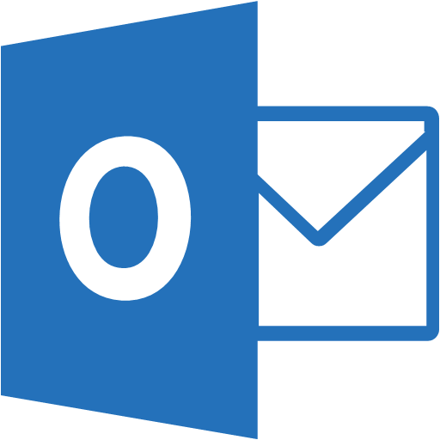
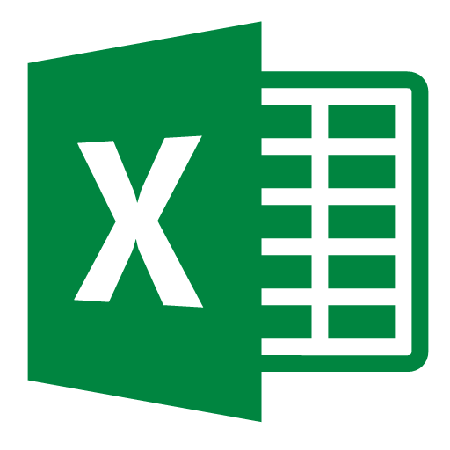
Microsoft Graph bindings for Functions
React to:
Mail messages
Calendar events
Personal contacts
OneDrive items
Read from:
Excel
OneDrive
Write to:
Excel
OneDrive
Outlook messages
+ more with identity support for API calls

Slide 38
Demo

Slide 39
In review…
Serverless = focus on your business logic not infrastructure
Event Grid – manage all events in one place
Logic Apps – compose serverless workflows
Azure Functions – author serverless code
Secure access
Work with your data
Integrate with existing business apps
Manage no servers

